Slide 1
Sizes
And why they matter? – (Physics)
Muhammad Arsalan and Abdullah Ashar

Slide 2
Sizes
Sizes is a point no one mentions these days. They are very important and they do matter in our day-to-day lives.

Slide 3
PROBLEM
Picometer
The “shortest” unit to measure distance.
MICROMETER
Short way to measure distance.
METER
The standard
Kilometer
The biggest size available.

Slide 4
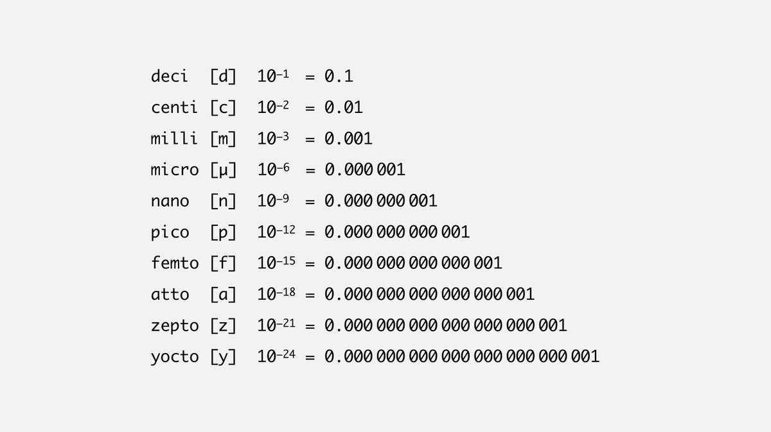
The Comparison

Slide 5
PICOMETER
The Unit
Its Use
It is the smallest unit used by A-Level Students
It is use to measure ‘small’ objects and their sizes.
Examples
Application
Atomic Diameter
Particle physics, Quantum physics, Chemistry and Acoustics.

Slide 6
Question What is the size of the Pico?
10³
WRONG
10¹²
CORRECT
10⁹
WRONG
10⁻¹⁰
WRONG

Slide 7
PICOMETER IN USE
Atoms…

Slide 8
ATOMS

Slide 9
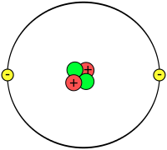
Atom’s MODEL
What is this?
This is a helium atom with two electron, neutrons, and protons.
Why this?
This is what a simple atoms is like.
What Size?
It is 62 picometers in diameters. (Which is 6.2 x 10⁻¹³ m)

Slide 10
CALCULATE AREA
Diameter
Answer (In Meters)
62 Picometers
3.90 x 10⁻¹⁰ Meters

Slide 11
What else?
DECA
KILO
TERA
BIG
Bigger
Biggest
10¹
10³
10¹²

Slide 12
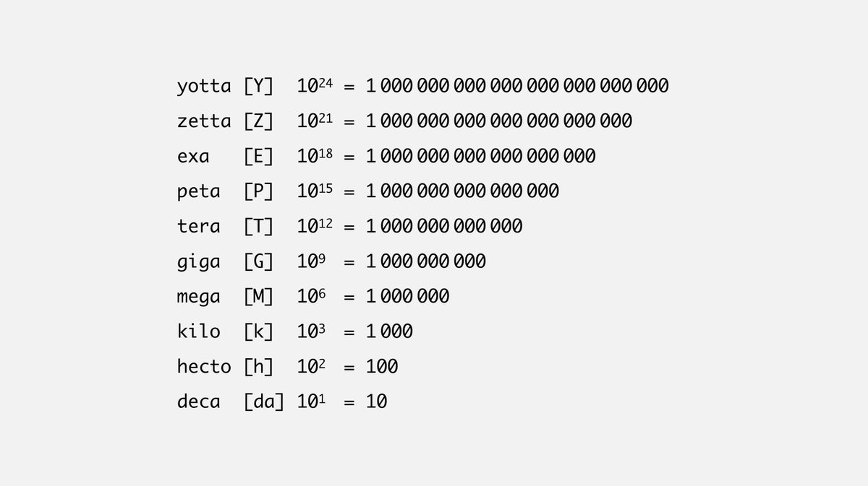
The Comparison

Slide 13
Question What is the size of the KILO?
10⁻³
WRONG
10⁻⁶
WRONG
10⁻⁹
WRONG
10⁻¹²
CORRECT

Slide 14
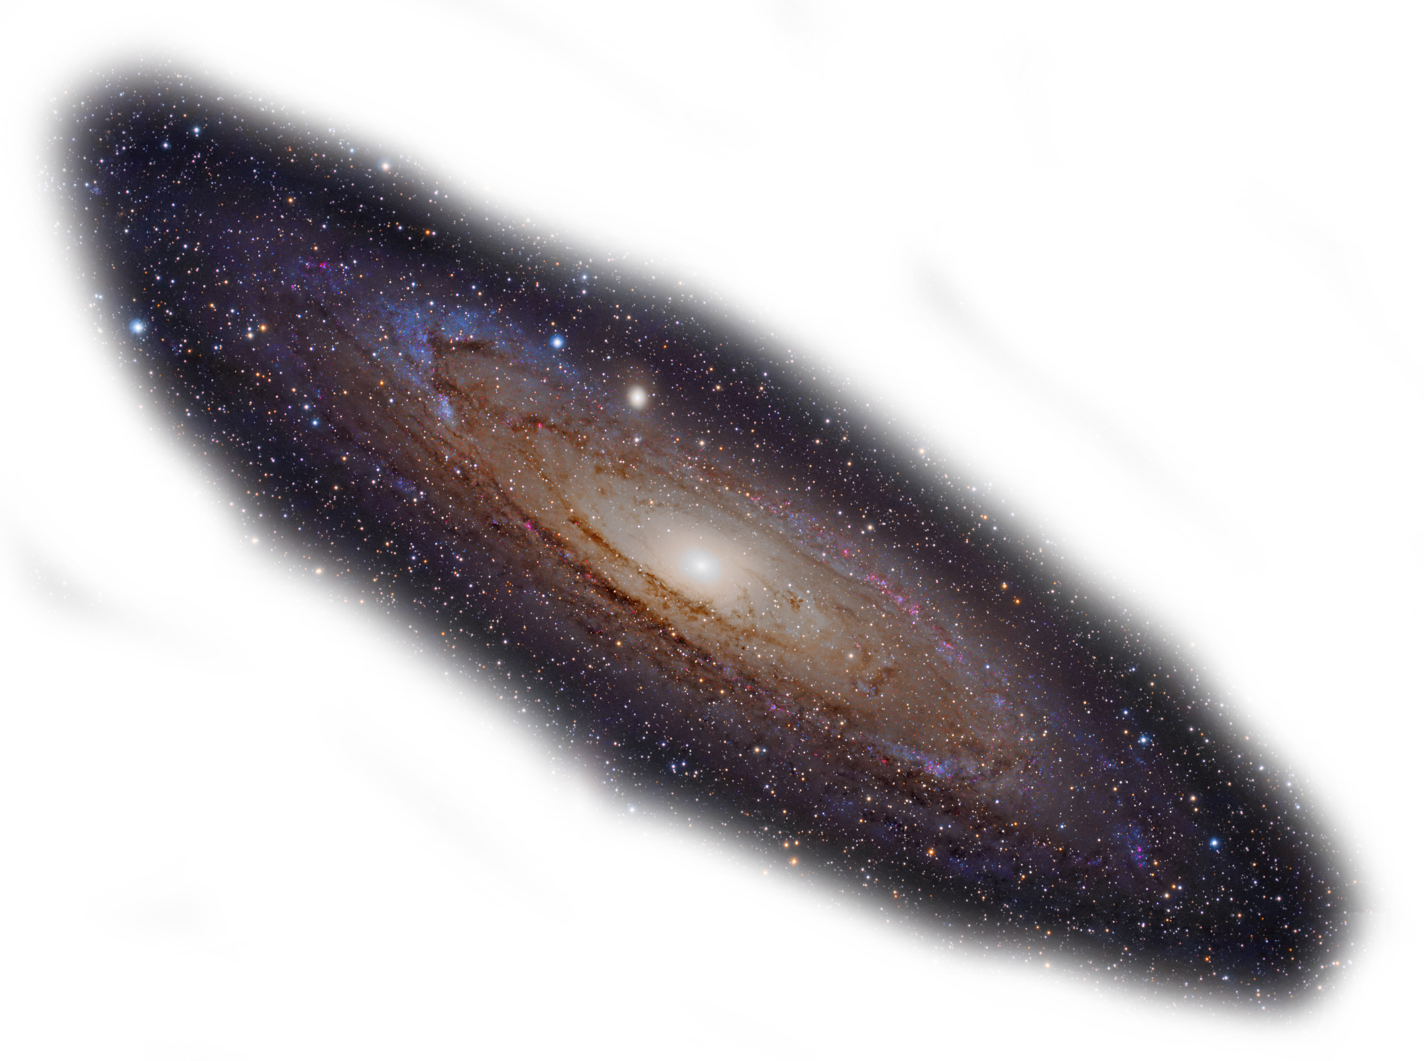
Galaxy’s Size
What is this?
This is a galaxy?
Why this?
This is OUR galaxy.
What Size?
It is 1 terameter (or 10¹² meters long).

Slide 15
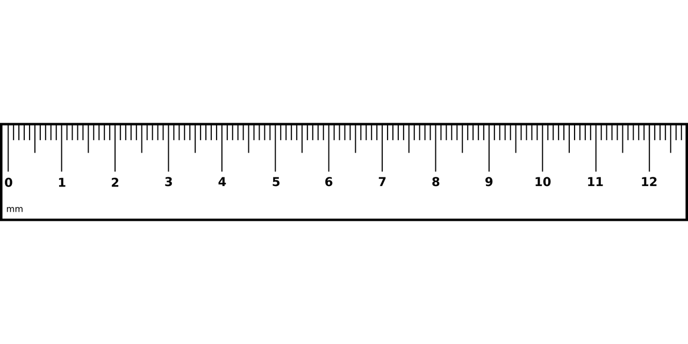
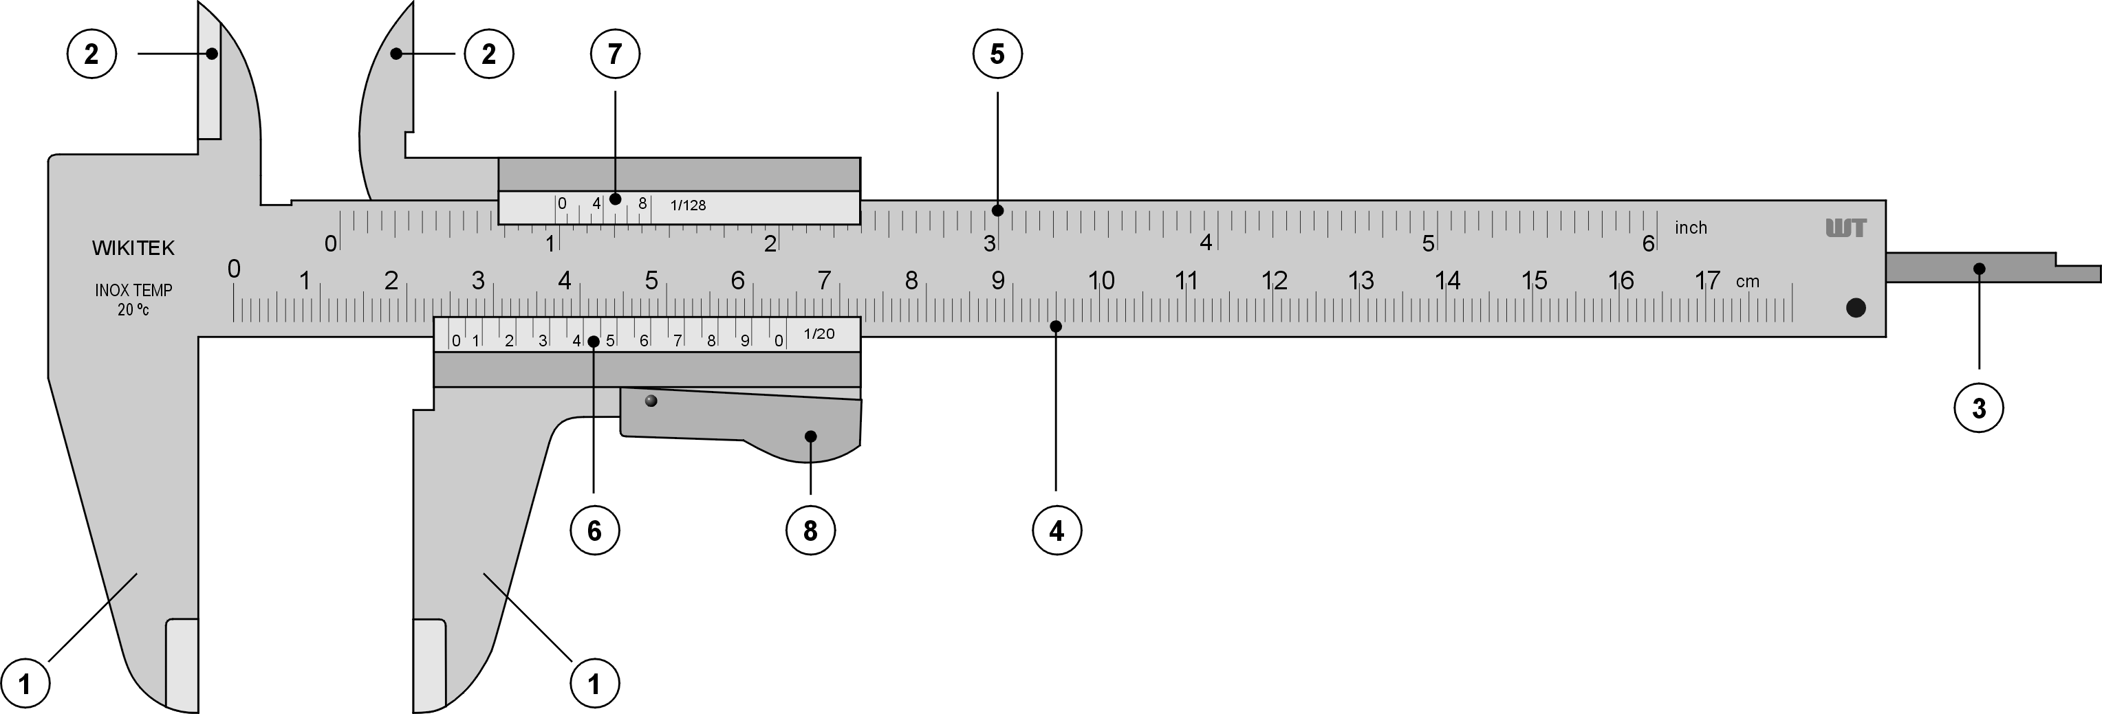
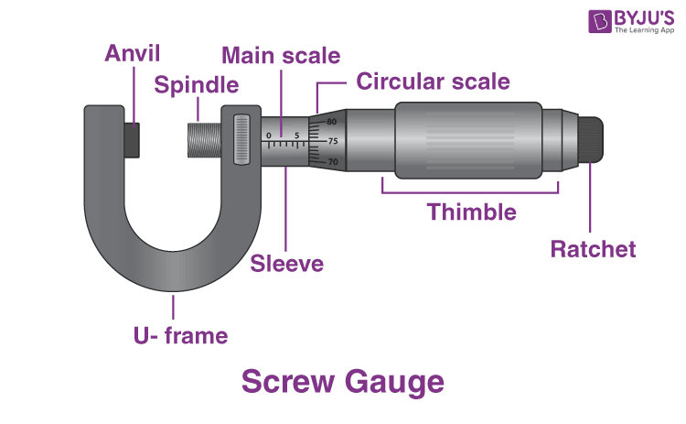
Rules of measurement
Ruler
A ruler is used to measure ‘average’ sized items. Examples: Your pencil, eraser sharpener.
Vernier Callipers
This is used to measure small objects and their inner/outer diameter with precision. Examples: Toothpaste cover.
Micrometre Screw Gauge
This is used to measure even smaller objects with even higher precision. Examples: Tiny Marble Balls

Slide 16
SUMMARY
So in summary sizes do matter, especially in physics where we are constantly measuring things be it vector or scalar. These measurements can be made using any units but certain unit fit the vibe better than the others.

Slide 17
THANK YOU
Muhammad Arsalan
https://jis-grade12.web.app/
JIS | Al-hussan
Size matters

